Slide 1

SBERBANK RUSSIAN
HOUSING MARKET
CAN YOU PREDICT REALTY PRICE
FLUCTUATIONS IN RUSSIA’S VOLATILE
ECONOMY?

Slide 2




Our Team
Baran Berkay
Barakçin
Baki Bozat
Emre Tunçay
Mustafa Yıldırım
Economics
Management
Economics
Economics

Slide 3


Ahmet Burak
Çakmak
Ege Baştürk
Economics
Economics

Slide 4
Our Roadmap
01
Project Selection
02
Data Exploration Report
03
Machine Learning Process
04
Conclusion

Slide 5



Project Selection
Sberbank started a competition on Kaggle to predict housing price in Russian market.
The training data is from August 2011 to June 2015, and the test set is from
July 2015 to May 2016.
In this competition, Sberbank is challenging Kagglers to develop algorithms
which use a broad spectrum of features to predict realty prices.

Slide 6
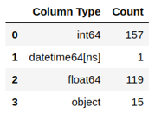

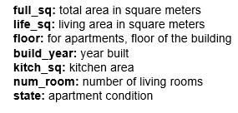
Training Data
In our training data, we have 15 categorical variables, 276 numerical variable, 157 of them are integers and 119 are floating. Finally, we have 1 time variable - datetime object.
Feature list and their
descriptions
Feature List
In our training data, we have 15 categorical variables, 276 numerical variable, 157 of them are integers and 119 are floating. Finally, we have 1 time variable - datetime object.

Slide 7
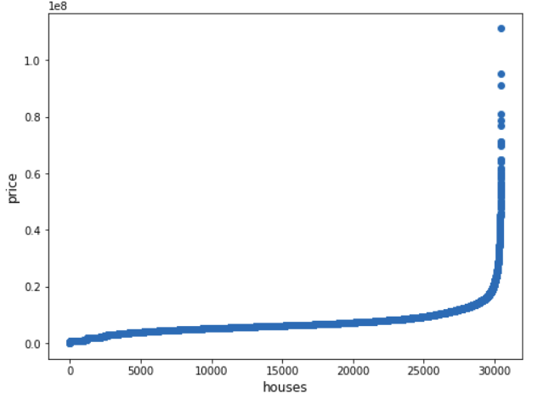
Statistical Exploration of Features
Price as a Feature
To detect outliers, we plotted our
target variable “price_doc”.
Then, we created a feature that
shows monthly mean prices of
houses
There is an increase in house
prices by time.

Slide 8
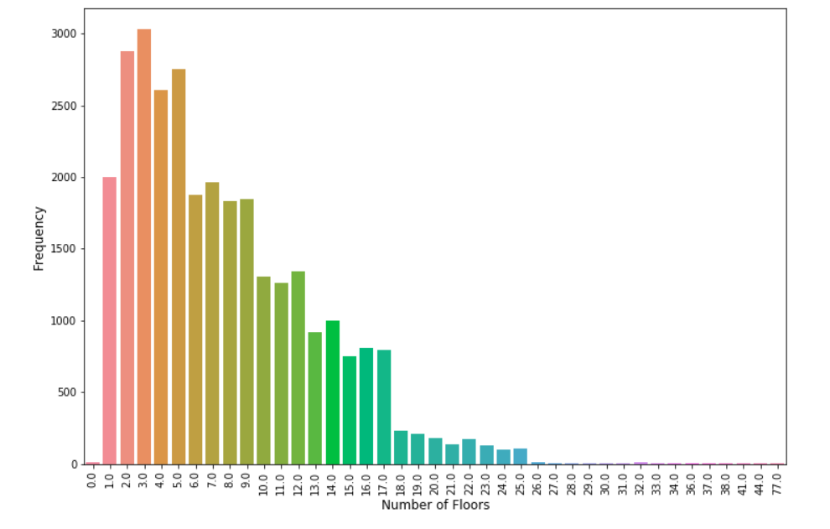
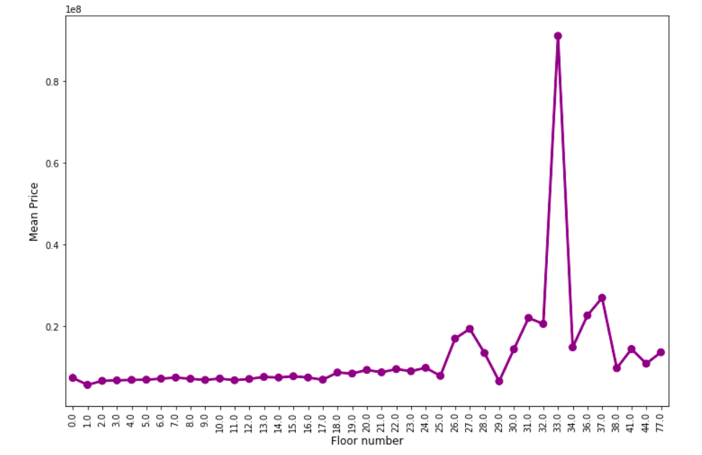

The pilot below shows the counts of the floor numbers. Most of the buildings are in the second third floor.
This shows an overall increasing trend. A sudden increase in the house price is also observed at floor 18.
Notes:
1

Slide 9
Employment of ML Method
A decision tree is a decision support tool that uses a tree-like model of decisions and their
possible consequences, including chance event outcomes, resource costs, and utility. It is one way to display an algorithm that only contains conditional control statements.
As seen, there are so many parameters at determining house prices. To determine which features are important, we use XGBoost.
After that, we are going to use Decision Tree Regressor which we found most proper ML algorithm to predict house price by our research.
1
3
Decision trees are commonly used in operations research and operations management. If, in practice, decisions have to be taken online with no recall under incomplete knowledge, a decision tree should be paralleled by a probability model as a best choice model or online selection model algorithm.
Decision Tree Regressor divide data into
branches and after that it apply regression to each node of tree.
When we want to predict a house price, first the model locate the datapoint to proper node and after that apply regression to
predict prices.
2
4
Notes:
1

Slide 10
Machine Learning Process
Decision Tree Regressor divide data into
branches and after that it apply regression to each
node of tree.
Regression
Decision Tree
Conditional control statements and a best choice model or online selection model algorithm.

Slide 11
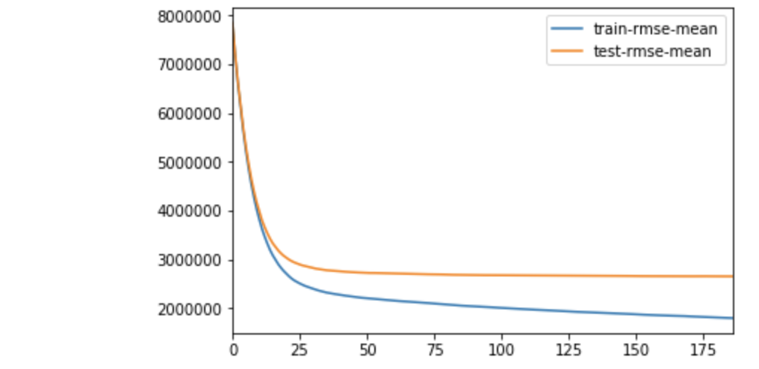
Application of ML Model
01
Appliance of XGBoost
We used XGBoost to decide which variables are most import in our model. We set learning rate as 0.1 and max_depth as 5.
We tried to detect how the rmse of our train and test datas changes by iterations

Slide 12
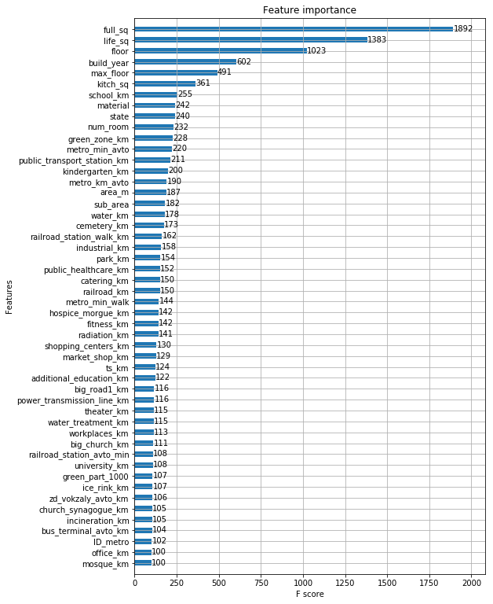
02
Output of XGBoost
We determined that the best parameters for our machine learning model are full_sq, life_sq, floor, build_year, max_floor, kitchen_sq, school_km, material and state.
We build our model according to these parameters. We applied these features in coding phase.

Slide 13
03
Results
The R-Squared on training dataset was 0.6507. The accuracy ratio for the competition named Sberbank Russian Housing Market was RMLSE which means Root Mean Logarithmic Standard Error. Our test made 0.39842 Root Mean Logarithmic Standard Error which is better than Training Mean Benchmark (0.53347) in the Kaggle by 0.13505. Our ranking would be 2868th if we would submit this model on time. The winner of the competition had 0.30087 which is pretty lower than our standard errors. We think that we did a pretty good job since this was our first try but we know that we have a lot to go.

Slide 14
Thank you

